Slide 1

Automatic Text Summarization
Group 5
Final Results

Slide 2
Content
Task
Implementation
Step 1 | Content Selection
Step 2 | Creating Hierarchies
Step 3 | Creating Summaries from Hierarchies
Evaluation

Slide 3
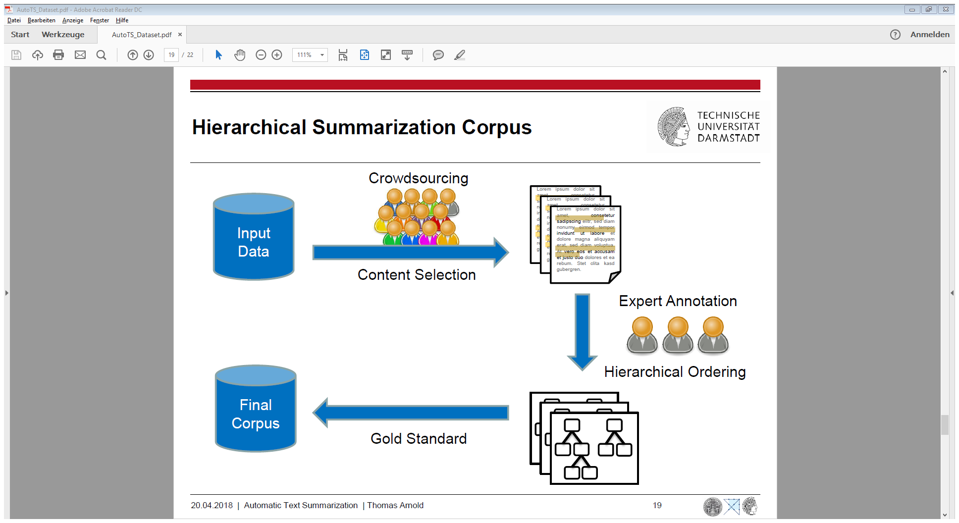
Hierarchical Approach
Task
Implementation
Evaluation
content selection
documents
hierarchical
ordering
summaries
creating summaries
from hierarchies

Slide 4
Step 1 | Content Selection Data Analysis
Task
Implementation
Evaluation
Nugget ratios
~ 14% nuggets per topic
Nugget structure
~ 82% are complete sentences
No words, that occur primarily in nuggets or non nuggets

Slide 5
Step 1 | Content Selection General Idea
Task
Implementation
Evaluation
Approach: Learn a classifier to recognize nuggets
Use binary labeled training data from all 10 given topics
They now have 300 Associate Offices in 25 countries. 0
ATTEND takes about 30-60 days to become effective. 1
Get up early in the morning. 0
…
Labeled Data
Diet is often part of the problem. 1
…

Slide 6
Step 1 | Content Selection Approaches
Task
Implementation
Evaluation
FastText Classifier
Naive Bayes
Fully Connected Neural Network
Convolutional Neural Network

Slide 7
Step 1 | Content Selection Approaches
Task
Implementation
Evaluation
FastText Classifier - Bad
Naive Bayes - Bad
Fully Connected Neural Network - Bad
Convolutional Neural Network - Okay

Slide 8
Step 1 | Content Selection Convolutional Neural Network – Preprocessing
Task
Implementation
Evaluation
gensim simple preprocess only sentences between 5 and 50 words, pad them to 50 words
Negative Example
I don't know.
U.S. History II
Attendance and tardies!
All-School Assemblies

Slide 9
Step 1 | Content Selection Convolutional Neural Network – Architecture
Task
Implementation
Evaluation
Input words as 300 dimensional embeddings (GloVe)
Random Search to find good Parameters with early stopping
Criteria:
Recall > 0.05 Precision as high as possible
Implementation with Keras
Computation on Lichtenberg Cluster

Slide 10
Step 1 | Content Selection Convolutional Neural Network – Architecture
Task
Implementation
Evaluation
Parametername | Possible Range | Final Params
Batch size | [120, 180] | 150
Number of convolutional layers | [1, 2] | 2
Filter sizes per layer | [4, 7] | 6, 6
Number of filters per layer | [30, 60] | 47, 42
Optimizer | [adam, sgd, adagrad] | Adagrad

Slide 11
Step 1 | Content Selection Convolutional Neural Network – Results
Task
Implementation
Evaluation
Recall = 5.9%
Precision = 52%
Use 30 sentences with highest nugget probability score
Only most confident sentences if more predicted
Guarantees enough material if too few predicted nuggets

Slide 12
Step 2 | Creating Hierachies Generate Hierachies from Nuggets
Task
Implementation
Evaluation
Goal: insert Nuggets into tree
Insert one Nuggets after another
compare Nuggets (similarity =/= general/specific)
find right Bubbles for Nuggets (similar topics)
Prelimitaries:
removed Stopwords, removed words less then 2 characters, Stemming

Slide 13
Step 2 | Creating Hierachies insert Function
Task
Implementation
Evaluation
Insert()
recursive function
inserts new nuggets
Bubble
Nuggets
new nugget
APPEND
GO DOWN
INSERT ABOVE

Slide 14
Step 2 | Creating Hierachies compare and which Function
Task
Implementation
Evaluation
compare()
find right position for Nugget
compare TF-IDF scores
which()
find right Bubble for Nugget
uses NLTK path_similarity()

Slide 15
Step 2 | Creating Hierachies Evaluation of Hierarchies
Task
Implementation
Evaluation
We tried Annotation Tool from AIPHES
11% similarity average against Gold standard (same as Random Trees)
but
1300 Nuggets in gold standard versus 30 Nuggets we used
less Nuggets showed more similarity
our algorithm is slow (>30 min) with 300+ Nuggets
Find „right“ balance instead
1-5 Nuggets in each Bubble
5+ Bubbles in root node

Slide 16
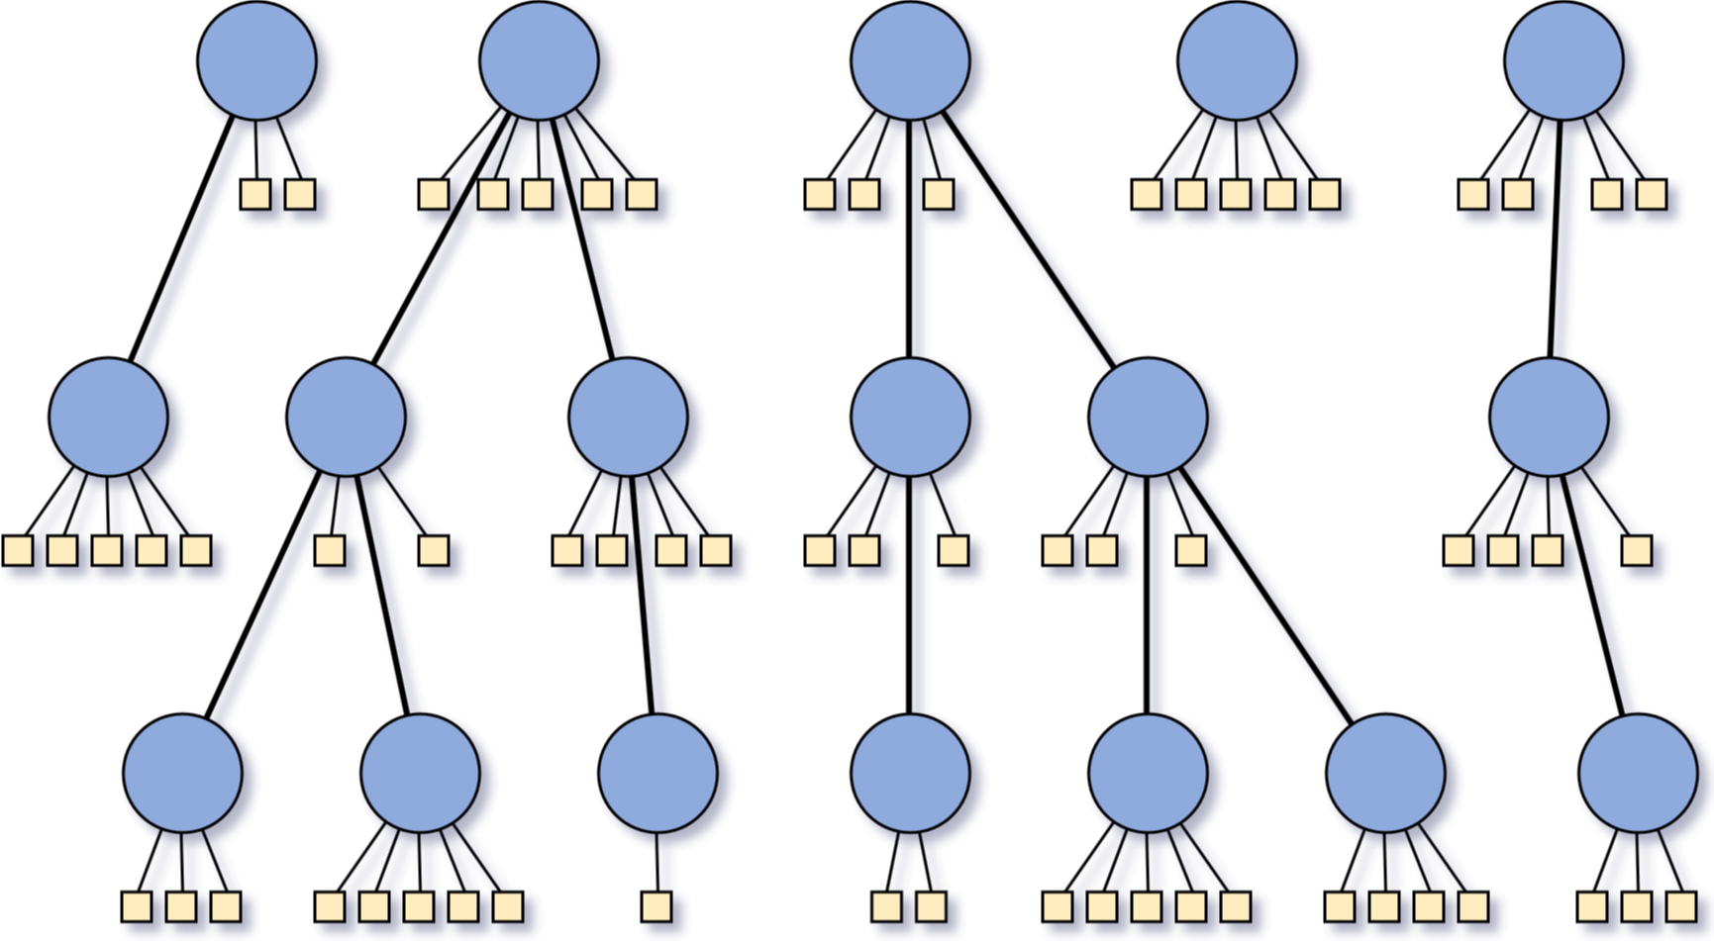
Step 3 | Creating Summaries from Hierarchies
Task
Implementation
Evaluation

Slide 17
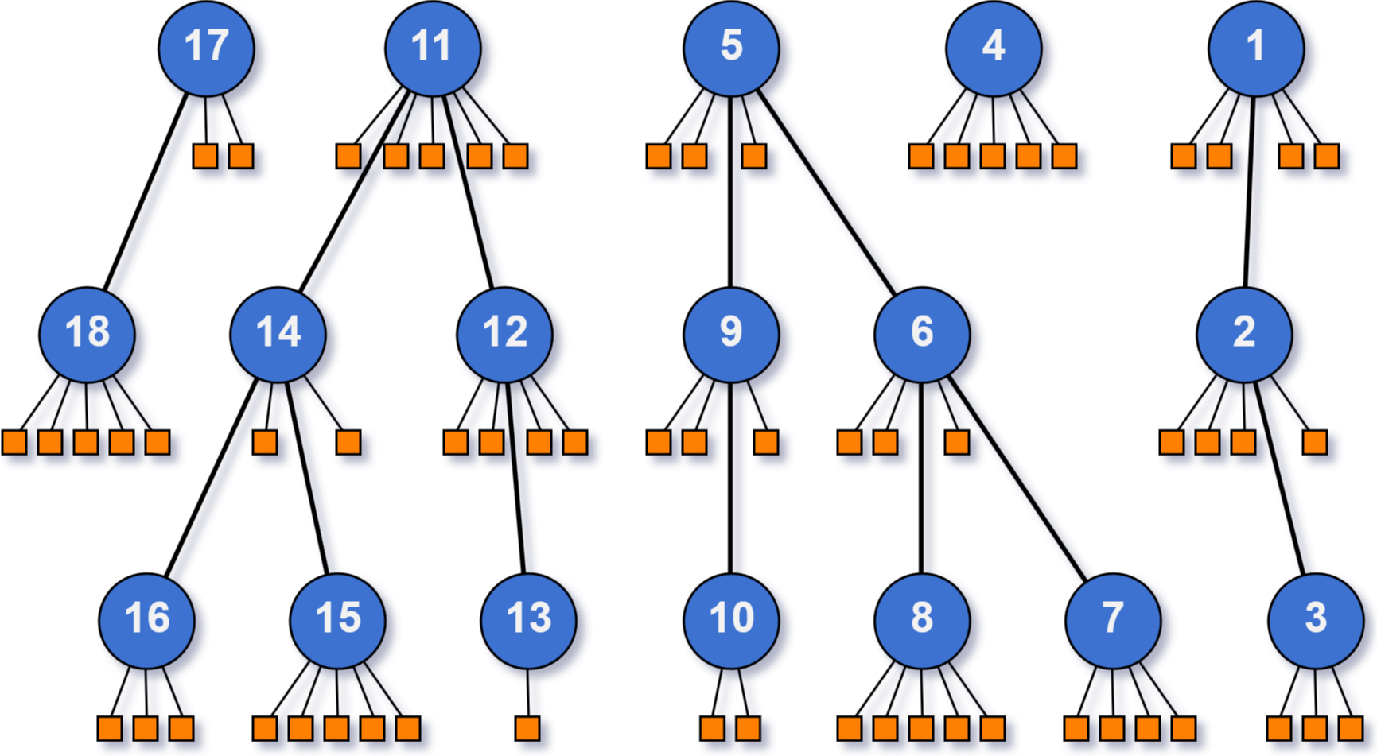
Step 3 | Creating Summaries from Hierarchies
Task
Implementation
Evaluation
first approach: Iterate in depth-first search order over the nuggets

Slide 18
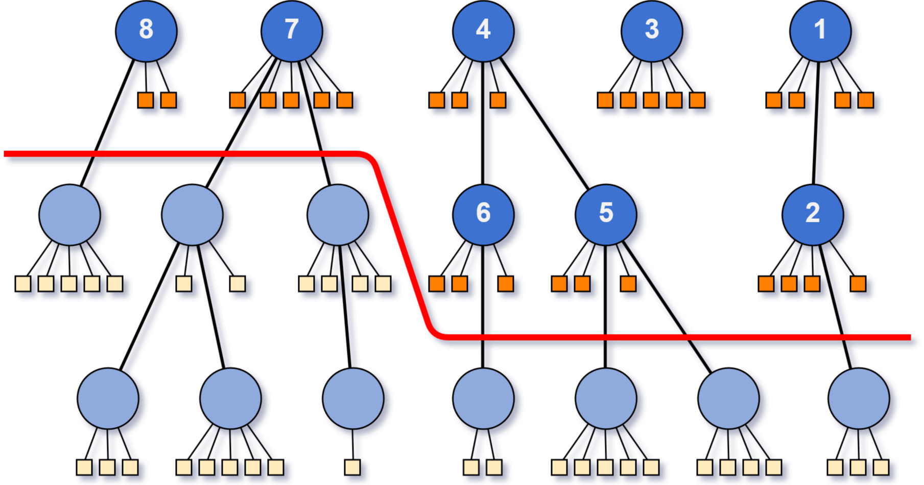
Step 3 | Creating Summaries from Hierarchies
Task
Implementation
Evaluation
cut layers off to get shorter summaries

Slide 19
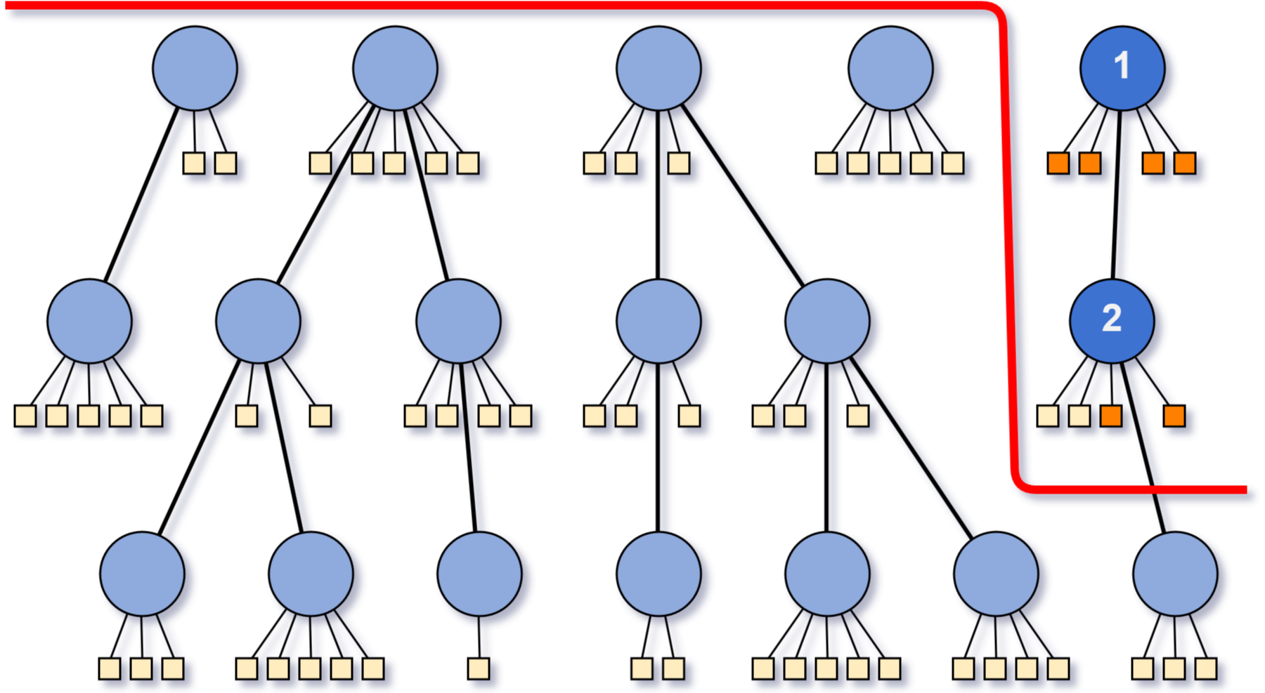
Step 3 | Creating Summaries from Hierarchies
Task
Implementation
Evaluation
problem when summaries are very short

Slide 20
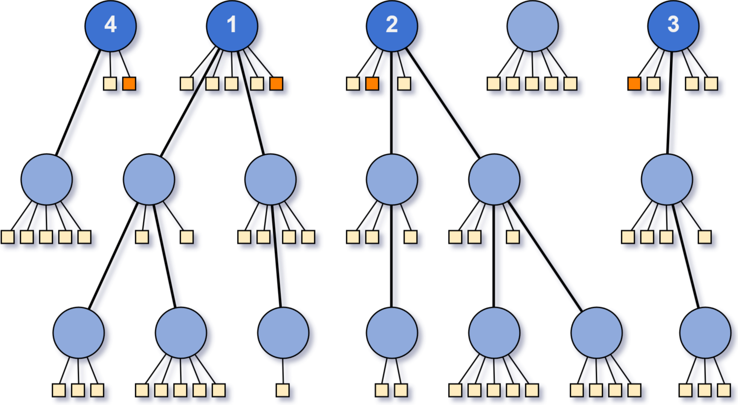
Step 3 | Creating Summaries from Hierarchies
Task
Implementation
Evaluation
select shortest sentences from root bubbles of the largest trees

Slide 21
Step 3 | Creating Summaries from Hierarchies
Task
Implementation
Evaluation
Baseline Text
Tool
Summary

Slide 22
Step 3 | Creating Summaries from Hierarchies
Task
Implementation
Evaluation
Gensim Summarizer
Implements variation of TextRank algorithm
Did not work well at all!
Baseline Text
Tool
Summary

Slide 23
Step 3 | Creating Summaries from Hierarchies
Task
Implementation
Evaluation
Sumy summariezers
Implementations of KL divergence, LexRank, LSA, Luhn algorithm, TextRank, …
Some produced barely acceptable output
Baseline Text
Tool
Summary
Notes:
Luhn: um so mehr wichtige Wörter in einem Satz, desto wichtiger für Zusammenfassung

Slide 24
Step 3 | Creating Summaries from Hierarchies
Task
Implementation
Evaluation
Summa summarizer
Also implementation of TextRank…
But with optimized similarity funktion
Worked really well for many topics
Baseline Text
Tool
Summary
Notes:
Original TextRank calculates similarity between sentences based on common words
plus divided by length -> no promotion of long sentences
Optimization: similarity by BM25

Slide 25
Step 3 | Creating Summaries from Hierarchies
Task
Implementation
Evaluation
Problem
Implementations mostly based on word count, sentence count or ratios
Never on character count

Slide 26
Step 3 | Creating Summaries from Hierarchies
Task
Implementation
Evaluation
Solution
Set word count so that approximately 600 characters are reached
Cut those sentences leading to more than 600
Adding sentences from hirarchy starting from the top level bubbles
make sure there are no duplicates
Notes:
Would have maybe been better to search for the bubble containing the last sentence in hirarchy and start adding sentences from there for more concurrency

Slide 27
Step 3 | Creating Summaries from Hierarchies
Task
Implementation
Evaluation
Observation that there are many definition sentences!
„ADHD is a brain-based disorder where the chemistry of the brain (neurotransmitters) is not functioning as it should.„
Extract
Add as first
sentence

Slide 28
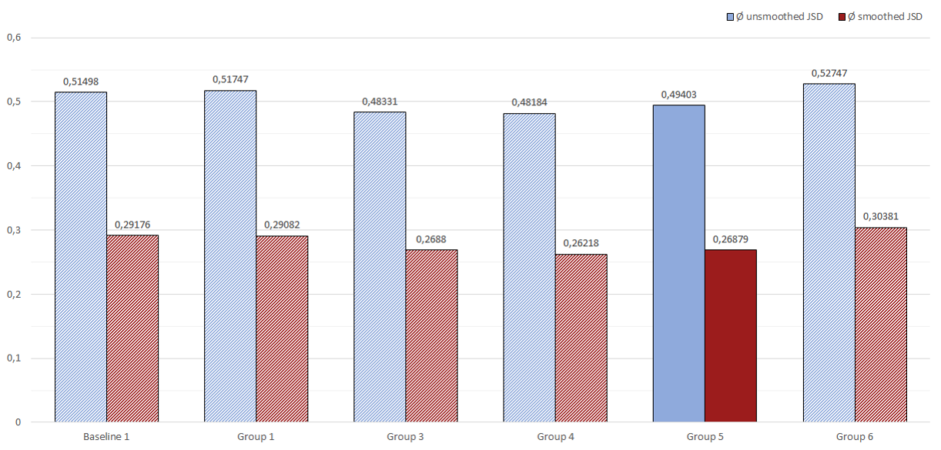
Evaluation Comparison with JSD
Task
Implementation
Evaluation

Slide 29
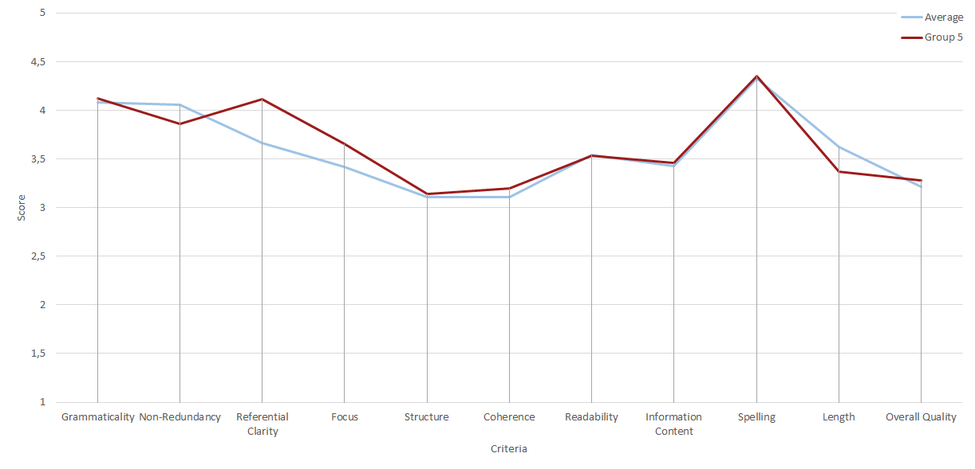
Evaluation Scores per Criteria
Task
Implementation
Evaluation

Slide 30
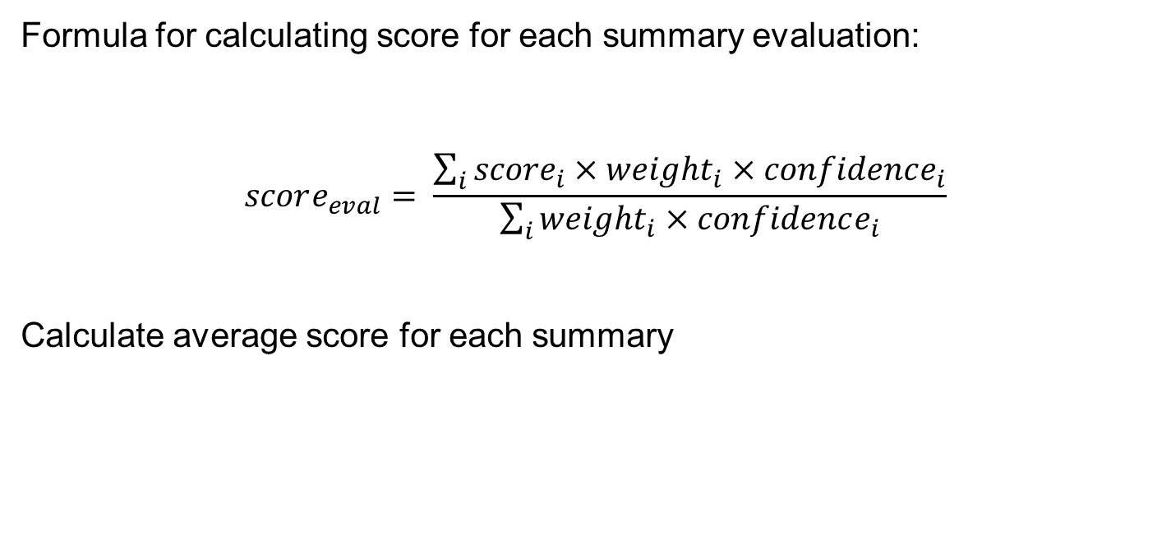
Evaluation Score Calculation
Task
Implementation
Evaluation
Formula for calculating score for each summary evaluation:
$$score_{eval}= \frac{\sum_{i}{{score}_{i}×weight_{i}×confidence_{i}}}{\sum_{i}{weight_{i}×confidence_{i}}}$$
Calculate average score for each summary

Slide 31
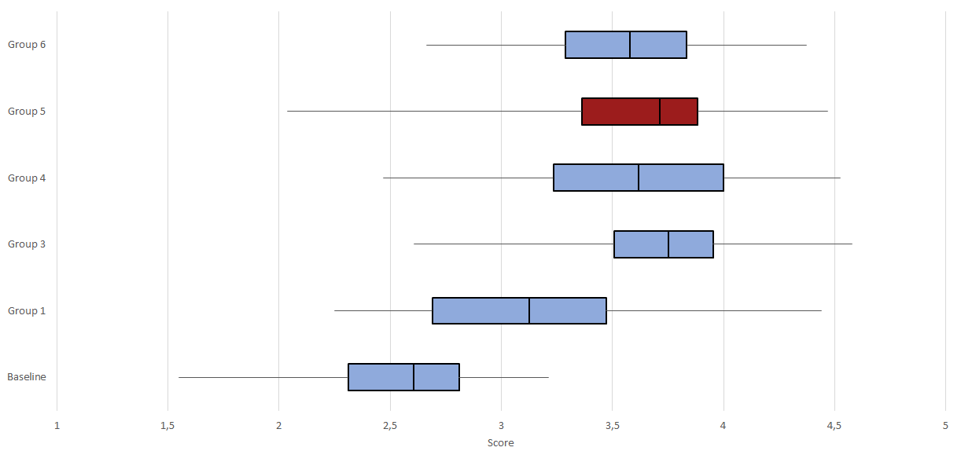
Evaluation Statistical Score Values over all Topics per Group
Task
Implementation
Evaluation

Slide 32
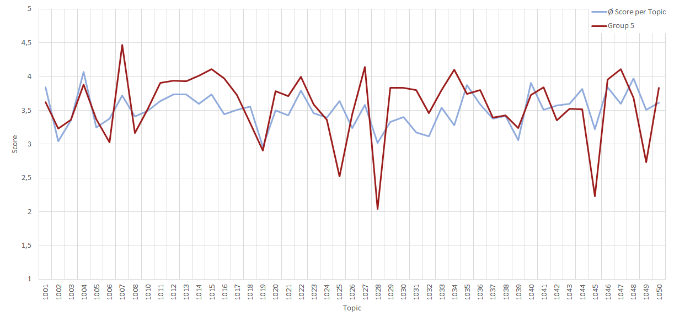
Evaluation Calculated Score per Topic
Task
Implementation
Evaluation

Slide 33
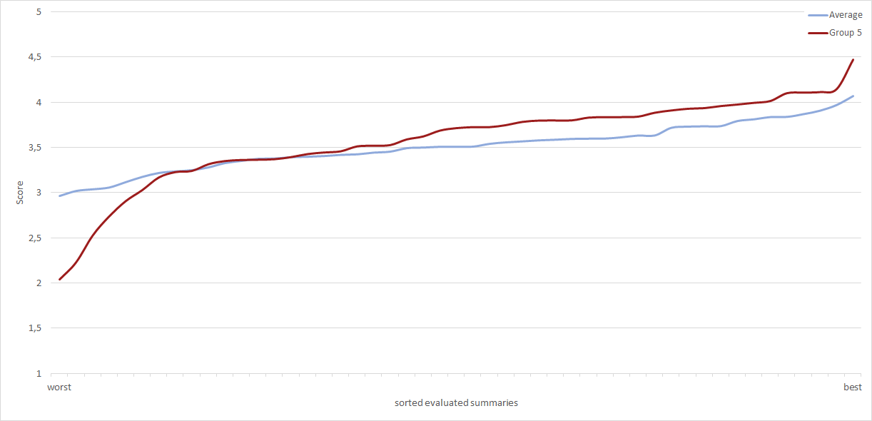
Evaluation Calculated Score per Topic – Sorted
Task
Implementation
Evaluation

Slide 34
Evaluation
Task
Implementation
Evaluation
Our worst summary (Topic 1028):
The parents are exhibiting some serious problems as well, such as drug abuse, alcohol abuse, criminal involvement, and domestic violence.
teen discipline, teen boot camp, alcohol abuse, Binge Drinking, Substance Abuse, Addiction, bad behavior, boot camp, children respect, parenting tips, aggressive behavior, James Lehman, Total Transformation Individuals suffering from mental health disorders may use alcohol and illicit drugs to decrease or mitigate their psychological distress 16 .

Slide 35
Evaluation
Task
Implementation
Evaluation
Our best summary (Topic 1007):
Fears and Phobias can be resolved with hypnosis and hypnotherapy Hypnotherapy is an ideal option because it is safe, effective, and non-invasive.
If a parent is afraid of spiders then a child can learn that fear and it could develop into a phobia.
Hypnotherapy is effective at helping you to overcome your fear by treating the anxiety caused by the trigger, and by re-training the mind to remember the original trigger in a way that does not create anxiety.
Medication can be very effective in treating phobias, especially social phobia and agoraphobia.

Slide 36
Questions ?

Slide 37
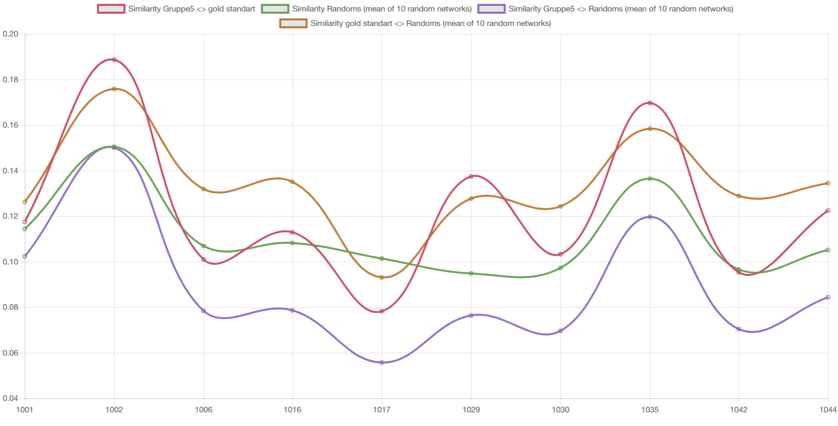
Percentage of Similarity of Hierarchy Trees
Summarys

